Slide 1
Smart Devices
What are they?

Slide 2
Defined by Techopedia.com
Techopedia explains Smart Device
Smart devices are interactive electronic gadgets that understand simple commands sent by users and help in daily activities. Some of the most commonly used smart devices are smartphones, tablets, smartwatches, smart glasses and other personal electronics. While many smart devices are small, portable personal electronics, they are in fact defined by their ability to connect to a network to share and interact remotely. Many TV sets and refrigerators are also therefore considered smart devices.
Definition - What does Smart Device mean?
A smart device, as the name suggests, is an electronic gadget that is able to connect, share and interact with its user and other smart devices. Although usually small in size, smart devices typically have the computing power of a few gigabytes.

Slide 3
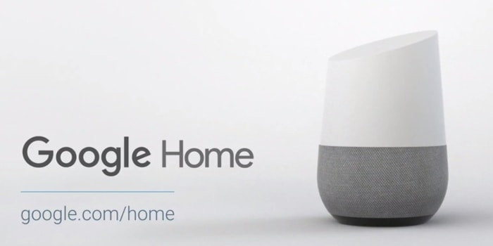
Google Home
The Google Home device can play music, but it's primarily designed as a vehicle for Google Assistant, which is Google's voice-activated virtual helper.
Google Home Command List

Slide 4
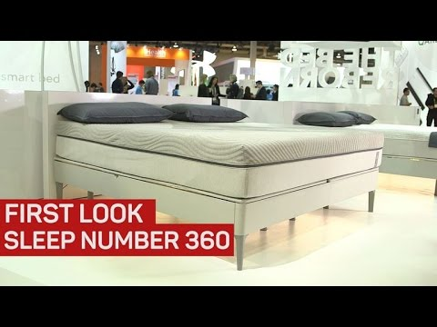
Smart Beds!?
Sleep Number’s 360 Smart Bed will your sleeping patterns, and make adjustments to firmness and temperature. Some consumers worry about wearable sleep trackers because they can move around during sleep. The Sleep Number system is integrated into the mattress, which provides a more complete and accurate data collection.

Slide 5
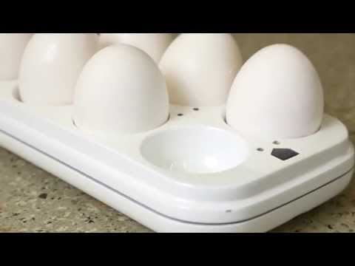
Smart Egg Tray
This smart device costs only $15.00! The Quirky Egg Minder is a smart egg tray that can tell you how many eggs you have at home AND when they’ve gone bad. LED lights on the tray tell you which egg is the oldest.
By using their special smartphone app, you can receive an alert when you start to run low. This feature is particularly convenient when you're at the grocery store and can't remember how many eggs you have left at home!

Slide 6
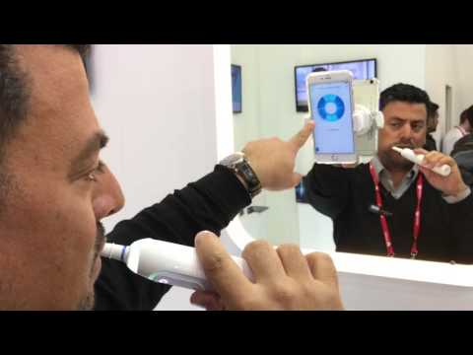
Oral B Genius Brush
This smart toothbrush connects to your smartphone via Bluetooth. The real innovation is this: the device uses facial recognition to track where you've brushed. This way, your phone will point out the places you’ve missed.
The app will also provide real-time visual coaching on brushing time and pressure. It is so smart, pressure sensors will automatically slow down its brush speed to protect you from excessive brushing.

Slide 7
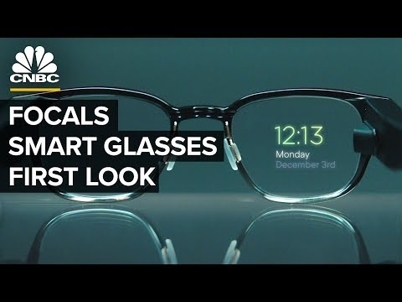
Smart Glasses: Focals
The holographic display can only be seen by the wearer, and allows you to respond to texts, notifications, reminders, get directions, check the weather, call an Uber. Focals also come with Alexa built-in. Ask Alexa to play music, hear the news, see the weather, control your smart home and more.
Loop, a four-directional joystick, is used for interaction by pressing on it to click. This allows you to do things without lifting your hand. The glasses come with a Loop, charging case and sun clips. The battery is supposed to last about 18 hours.

